Slide 1
The Application of Genetic Programming to Financial Modeling
The Power of Evolution
Evolutionary Algorithms
  Genetic Algorithms
  Genetic Programming
Financial Analysis of the Stock Market
Our Genetic Program
Why Genetic Programs? Advantages and disadvantages over other techniques
Automated Trading
Extensions to the algorithm \ future work

Slide 2
1. The Power of Evolution
Evolution is everywhere in modern life
  In the natural environment – process of natural selection
  Occurs in our own immune system – development of antibodies
  Development of our brains – pruning of less useful neurons
  Occurs in our economy – businesses need to adapt or fail
Daniel Dennet – evolution requires just two things:
  Imperfect replicators – agents that copy themselves imperfectly
  Selection pressure from the environment

Slide 3
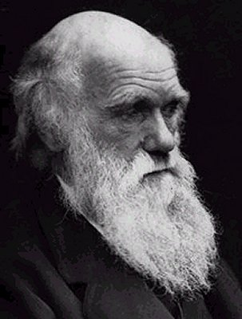
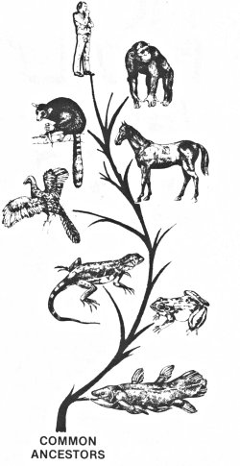
Darwin “Descent through modification over time”

Slide 4
2. Evolutionary Algorithms
We can simulate evolution in a computer
Evolutionary algorithms are useful for solving problems where a problem is too complex or poorly understood to solve with more formal methods (such as with math or logic).
Genetic Operators:
  Selection
  Mutation
  Cross-over

Slide 5
Selection
Select a portion of the population for reproduction using a FITNESS FUNCTION
  There are a lot of problems that are extremely hard to solve formally, such as the travelling salesman problem, or creating a model of the stock market
  However, it is often easy to quantify how effective a potential solution to a problem is, i.e. how far do you need to travel (travelling salesmen problem) or how much money would it have made (financial model).
Do so probabilistically to allow retention of some less fit individuals
  Promotes genetic diversity
  Helps prevent the algorithm becoming stuck in local maxima \ or minima
  Chart….
Three main algorithms:
Rank-based selection – assign ordinal numbers (ranks) to each individual based on fitness
Roulette wheel selection – choose probabilistically based on fitness, each slot in the wheel is proportional to the fitness
Tournament selection – randomly pick pairs of individuals, and select the fitter of the two.

Slide 6
Mutation
Evolution occurs due to modifications to the genome that occur in the replication process
In nature, this occurs through mutation and cross-over
Primary driver of evolution in asexual reproduction – e.g. single-celled organisms (although some bacteria can exchange RNA molecules)
Can be:
  Point mutation (change a single gene or allele)
  Insertion
  Deletion
  Swapping of DNA
  Reversal of a section of DNA

Slide 7
Cross-Over
Sexual reproduction
Genome is created from both parents
Produces greater diversity in the subsequent offspring, as no children are exact or nearly exact replicas of their parents
Representation Problem
How do you represent the solution to a problem
Genetic Algorithm: String or sequence of ‘genes’. E.g. a string of 1’s and 0’s, or letters, or real numbers
Genetic Program: An abstract syntax tree (AST) representing a computer program

Slide 8
Abstract Syntax Trees
All formal languages can be represented as an abstract syntax tree
Encodes a context free grammar (CFG)
Can represent a mathematical expression, Boolean expression, or a complete program
Consists of Terminals (leaves) and Non-terminals (intermediate nodes)
Some examples:
X + 2y – 3:
minus
plus
3
x
2y

Slide 9
Boolean example:
(A && B) || !C
Evaluation can be performed via a depth-first recursive traversal of the tree
Non-terminals are operators e.g.
  AND,OR,NOT,XOR,IF,IFF
  +,-,*,/, sine, cosine, square, cube, square root, logarithm
Terminals are values that are either constants or cells in your dataset
OR
AND
NOT
A
B
C

Slide 10
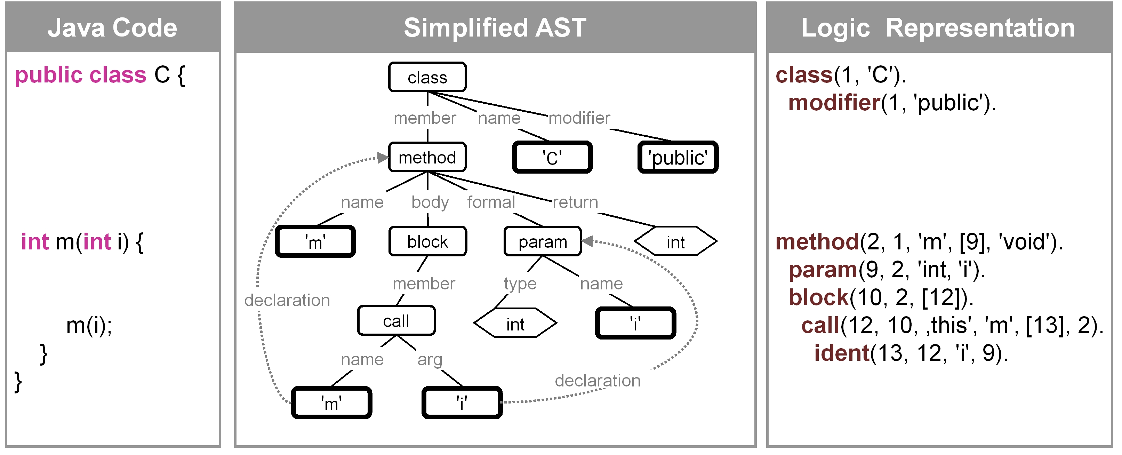
Sample AST for a Small Class

Slide 11
The Algorithm
Create initial population completely at random
Iterate through the population of individuals, assigning a fitness value from the fitness function
Selection: Probabilistically select a portion of the population based on their fitness
Cross-Over: Select individuals probabilistically, based on fitness, to “mate”, creating new individuals for the next population through cross-over. Repeat until the population is it’s original size (prior to selection)
Mutation: Iterate through the new population, performing a mutation on each new individual using a pre-determined probability
Repeat 2-5 until
    The most fit individual’s fitness is above a certain threshold, or
    A certain number of iterations have been met.

Slide 12
Implementation of Genetic Operators
Initial population created at random, generally adhering to some size constraints (max no. tree-nodes or chromosome length)
Selection: fitness function determined by the problem domain
Mutation and Crossover: GA’s and GP’s differ in the implementation of the genetic operator due to the different encoding
In genetic algorithms, you are manipulating a one-dimensional data structure, such as an array or list
For genetic programming, you are manipulating the AST, which adds additional complexity
Configure algorithm with the
  Percentage of individuals created from selection
  Percentage of individuals created through cross-over
  Mutation probability (usually applied to the whole population)
Art form – selecting the correct parameters

Slide 13
3. Financial Analysis of the Stock Market
The problem:
  Predict future stock prices
The data:
  Daily stock prices from Yahoo finance.
    Open
    Close
    High
    Low
    Volume
  Chart…
Technical Analysis – Prediction of future price movements purely from charts and numerical analysis of prior price movements
Fundamental Analysis – Using fundamentals about a firm to predict it’s performance (the Warren Buffet style of investing):
  Earnings
  Dividends
  Price to book ratio
  Assets\Liabilities
  Market sentiment
  etc

Slide 14
Technical Indicators
We focus primarily on technical indicators
Using the “Technical Analysis” approach to investing
Moving Averages
Exponential Moving Averages
Pre-compute many different technical indicators for the particular stock to trade using historical prices

Slide 15
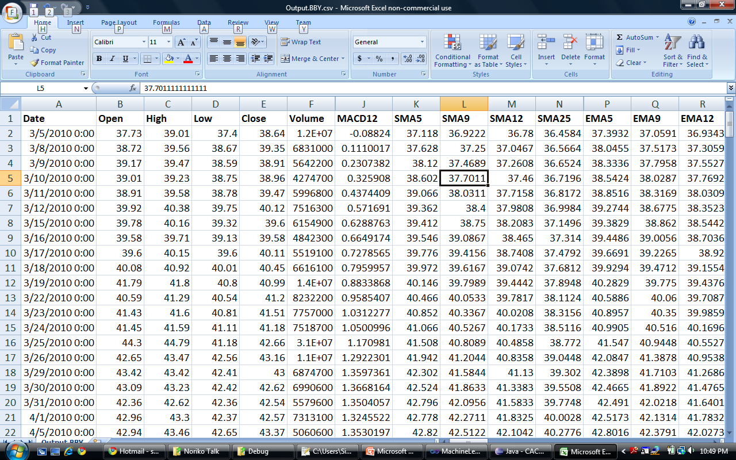
The Data

Slide 16
4. Our Genetic Program
Data points (indicators and prices) fed into the leaf level (as terminal nodes) of the evolved programs, along with some randomly assigned constants
Compute a mathematical or Boolean expression over these data points that outputs a value
Requires mapping of input\output data:
  Boolean inputs go through relational operators
  Boolean outputs – true = Buy, false = sell
  Mathematical outputs - > 1 Buy, <=0 Sell

Slide 17
Sample Run 1 – Mathematical Expressions
Non-Terminals
******************************
(TD):
565.9530 Fitness (TD) 3 Nodes BBY
------------------------------
Unary.Round
Unary.Round
[DayOfWeekIndx]
******************************
(TD):
686.9936 Fitness (TD) 4 Nodes BBY
------------------------------
Unary.Round
Binary.Abs
[CLV]
0
Terminals
******************************
(TD):
389.2572 Fitness (TD) 7 Nodes BBY
------------------------------
Unary.Step
Binary.Log
Binary.Multiply
e
4
Unary.Tan
[MinDow12]

Slide 18
Sample Run 2 – Boolean Expressions
Non-Terminals Terminals
******************************
(TD):
641.2275 Fitness (TD) 7 Nodes BBY
------------------------------
BooleanFunctions.Majority
BooleanFunctions.Not
TRUE
BooleanFunctions.Not
(-0.38 * [MACD12]) > 0.790552871204239
BooleanFunctions.Not
(-0.07 * [PercentVolumeOscillator]) > (-0.98 * [WeekOfMonth])

Slide 19
Sample Run 2 – Boolean Expressions
Non-Terminals Terminals
******************************
(TD):
1346.6535 Fitness (TD) 5 Nodes BBY
------------------------------
BooleanFunctions.XOr
BooleanFunctions.BiConditional
TRUE
(-0.34 * [EMA50]) > (-0.37 * [SMA50])
(0.31 * [MondayOfMonth]) > (-0.18 * [RelativeStrengthIndex])

Slide 20
5. Why Evolutionary Algorithms?
Advantages over other techniques
Easy to understand. Cf. a Neural Network: “What does node 57 do?”
Easy to implement
Highly configurable
Don’t suffer from the curse of dimensionality
Extensively researched and well-understood
Very flexible
Can be applied to any problem where you have a fitness function defined, and can come up with an appropriate representation
Output can be turned into an actual program, and can then be ran at speed in real-time
Easily parallelizable
Can be combined with other machine learning algorithms to enhance their performance, such as neural networks, decision trees, etc
Can be used to optimize more formal models

Slide 21
5. Why Genetic Programs?
Disadvantages over other techniques
Stagnation of population
Rapid pre-dominance of certain individuals over the rest of the population
Over-fitting
Provide the most fit solution that was evolved, not necessarily the optimal solution
Hard to determine the optimal parameters

Slide 22
6. Automated Trading
A History of Trading
The Pit: In the beginning, traders in the PIT use hand signals to place buy and sell orders
The Quants Arrive: Ed Thorpe invents the an algorithm for pricing options that eventually morphs into the famous Black Scholes options pricing model
Stats Hits Wall Street: A number of other mathematical techniques arise from the field of statistics, to take advantage of miss-pricings of contracts traded on the stock exchange, such as statistical arbitrage, pairs trading and other techniques built around mean reversion of prices.
Intelligence Amplification: Computers get faster and cheaper, the first electronic exchanges appear, and computational power is leveraged to assist humans in making trading decisions
Black box trading: Companies start to use computers to actually place trades in real-time in the stock market. Today it is estimated that 70% of the trades placed on the market are created by trading algorithms
AI: Companies are increasingly turning to machine learning algorithms to improve their trading operations. AI algorithms used in the real world include:
  Neural Networks
  Genetic Algorithms \ Genetic Programs
  Fuzzy Logic Programs
  Natural Language Processing algorithms to process and react to news

Slide 23
Why machine learning algorithms instead of mathematical models?
Future Work on Genetic Programming
Niching algorithms – encourage diversity by restricting mating to groups of similar individuals, or ‘niches’
Grammatical Evolution – separation of phenotype from genotype
Competitive evolution – antagonistic relationships between two species
Co-operative evolution – co-operative co-evolution between species
Evolution of species
The Baldwin Effect – intelligence amplifies the speed of evolution
Junk DNA – carry non-coding sections of DNA to allow for greater diversity

